Slide 1
LINQ
LINQ stands for Language Integrated Query
LINQ is a new technology introduced in .NET 3.5 with Visual Studio 2008 or later versions.
LINQ can be used with C# or Visual Basic.
LINQ (Language Integrated Query) is uniform query syntax used to retrieve data from different sources like an Object Collection, DB tables, XML etc.
LINQ always works with objects so you can use the same basic coding patterns to query and transform data in XML documents, SQL databases, ADO.NET Datasets, .NET collections, and any other format for which a LINQ provider is available.
LINQ is the collection of extension methods for classes that implements IEnumerable and IQueryable interface.
Linq uses System.Linq namespace it includes the necessary classes & interfaces for LINQ.
Enumerable and Queryable are two main static classes of LINQ API that contain extension methods.

Slide 2
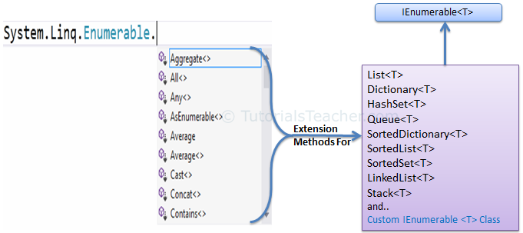
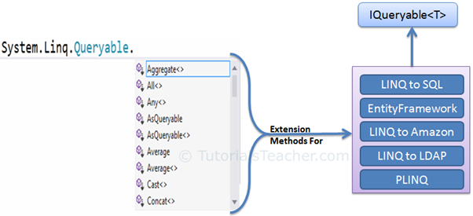
LINQ

Slide 3
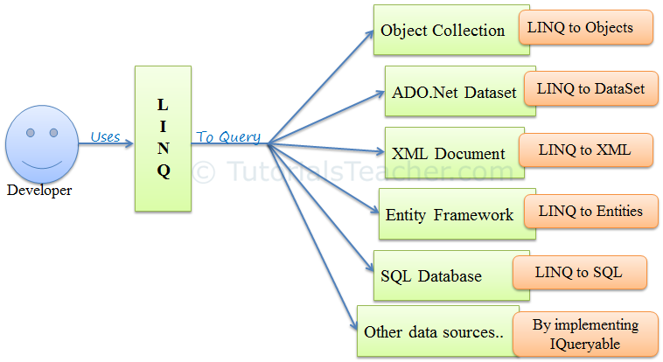

LINQ

Slide 4
Advantages of LINQ
Familiar language: Developers don’t have to learn a new query language for each type of data source or data format.
Less coding: It reduces the amount of code to be written as compared with a more traditional approach.
Readable code: LINQ makes the code more readable so other developers can easily understand and maintain it.
Standardized way of querying multiple data sources: The same LINQ syntax can be used to query multiple data sources.
Compile time safety of queries: It provides type checking of objects at compile time.
IntelliSense Support: LINQ provides IntelliSense for generic collections.
Shaping data: You can retrieve data in different shapes.

Slide 5

Core Assemblies in LINQ
The core assemblies in LINQ are:
using System.Linq
Provides Classes & Interface to support LINQ Queries
using System.Collections.Generic
Allows the user to create Strongly Typed collections that provide type safety and performance (LINQ to Objects)
using System.Data.Linq
Provides the functionality to access relational databases (LINQ to SQL)
using System.Xml.Linq
Provides the functionality for accessing XML documents using LINQ (LINQ to XML)
using System.Data.Linq.Mapping
Designates a class as an entity associated with a database.

Slide 6
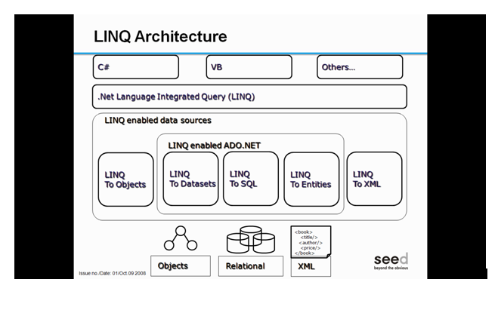


Slide 7
LINQ Query Syntax
There are two basic ways to write a LINQ query to IEnumerable collection or IQueryable data sources.
Query Syntax or Query Expression Syntax
Method Syntax or Method extension syntax
Query Syntax:
Query syntax is similar to SQL (Structured Query Language) for the database. It is defined within the C# or VB code.
from <range variable> in <IEnumerable<T> or IQueryable<T> Collection>
<Standard Query Operators>
<select or groupBy operator> <result formation>

Slide 8
Standard Query Operators
There are over 50 standard query operators available in LINQ that provide different functionalities like filtering, sorting, grouping, aggregation, concatenation, etc.

Slide 9
Classification | Standard Query Operators
Filtering | Where, OfType
Sorting | OrderBy, OrderByDescending, ThenBy, ThenByDescending, Reverse
Grouping | GroupBy, ToLookup
Join | GroupJoin, Join
Projection | Select, SelectMany
Aggregation | Aggregate, Average, Count, LongCount, Max, Min, Sum
Quantifiers | All, Any, Contains
Elements | ElementAt, ElementAtOrDefault, First, FirstOrDefault, Last, LastOrDefault, Single, SingleOrDefault
Set | Distinct, Except, Intersect, Union
Partitioning | Skip, SkipWhile, Take, TakeWhile
Concatenation | Concat
Equality | SequenceEqual
Generation | DefaultEmpty, Empty, Range, Repeat
Conversion | AsEnumerable, AsQueryable, Cast, ToArray, ToDictionary, ToList

